Slide 1
The separation of powers
Learning intentions:
Identify the role and composition of each branch of government.
Success criteria:
State the 3 branches of government, including their role and composition.

Slide 2
The three branches of government
There are 3 main branches of the Australian government:
The parliament/legislature
The executive
The judiciary

Slide 3
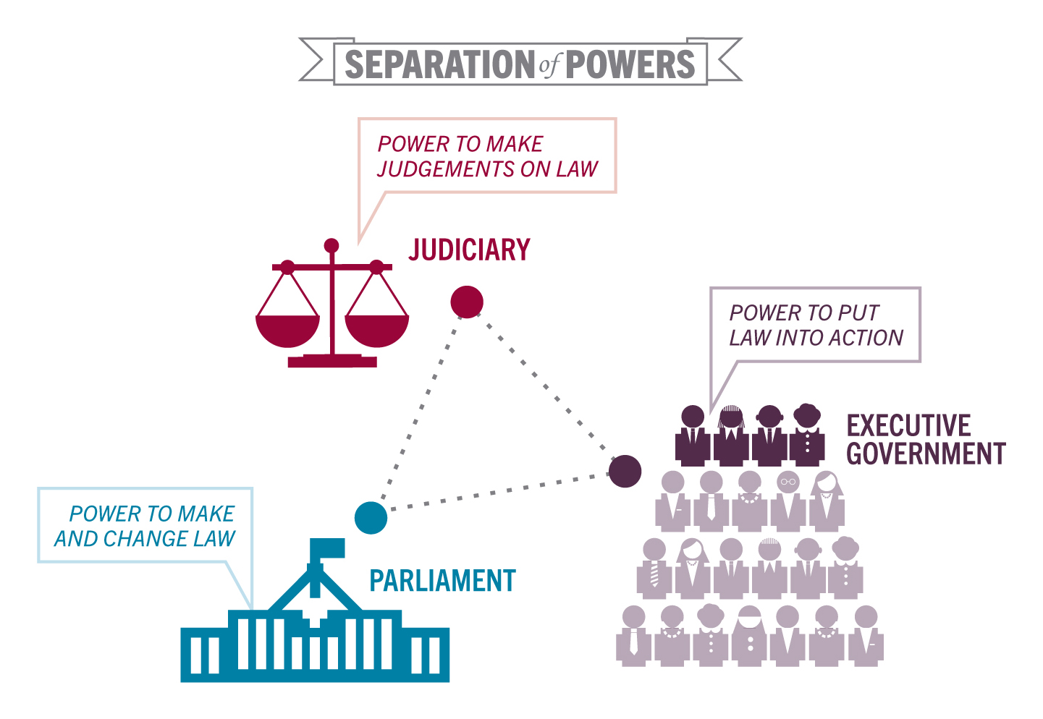

Slide 4
The Parliament/Legislative
This is the parliament, which has the power to make new laws and to change or repeal existing laws.
It consists of two separate ‘houses’ – the House of Representatives and the Senate – together with the Governor-General as the representative of the Queen.

Slide 5
The Executive
This is the branch of government with the responsibility of putting laws into action.
Executive power officially lies with the Governor-General, but is usually exercised by government ministers.

Slide 6
The Judiciary
This includes the judiciary and the courts.
These are responsible for enforcing the law and settling disputes that might arise under the law.
The High Court of Australia has the power to interpret and enforce the Constitution.

Slide 7
https://www.youtube.com/watch?v=BXXv3QrH4qs

Slide 8
Worksheet!

Slide 9
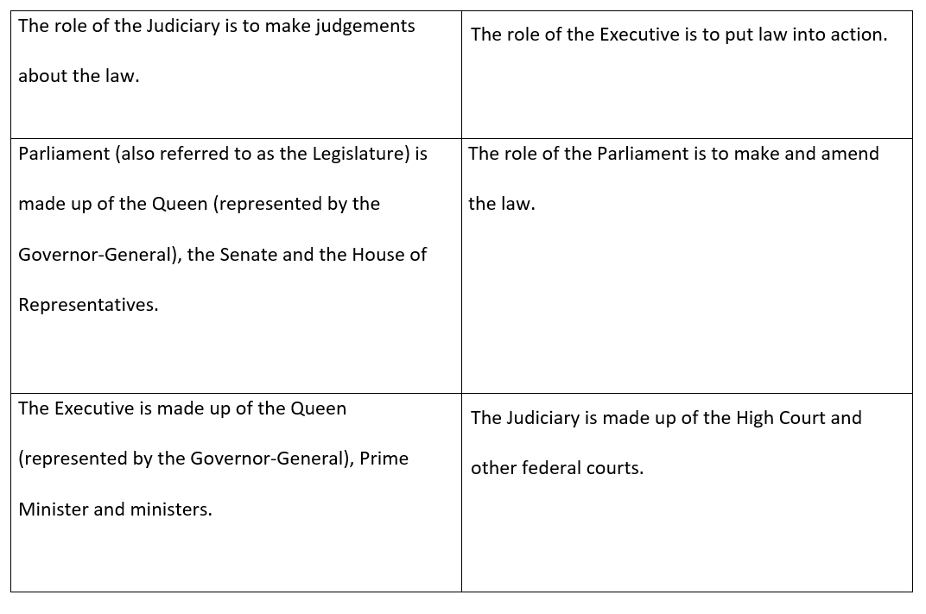

Slide 10


State and federal roles
The Australian Constitution lists those areas of government that come under federal and state responsibilities.
That means that the federal government and state governments have different roles.

Slide 11
Refer to this table
FEDERAL | STATE

Slide 12

Guessing game!
Sort out the responsibilities you are given into whether they are Federal or State

Slide 13
FEDERAL | STATE
Foreign policy | Schools
Currency | Hospitals
Immigration | Roads and railways
Defence | Police
Weights and measures | Mining and agriculture
Social security | Prisons
Trade and commerce | Public transport
Postal and communication services | Utilities such as electricity and water

Slide 14

Should disposable products (such as plastic cups, plates, and cutlery) that contain less than 50% of biodegradable material be banned?
https://www.youtube.com/watch?v=PFzYnLI9xxw

